Slide 1


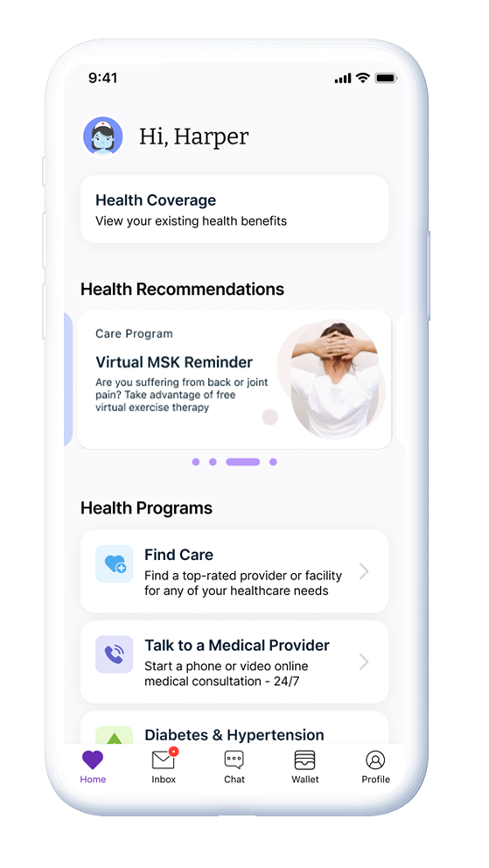








HealthJoy Makes it Easier
to be Healthy and Well.
HealthJoy is the virtual access point for all your healthcare navigation and employee benefits needs. We’re provided free by your employer to help you understand and make the most of your benefits. We connect you and your dependents with the right benefits at the right moment in your care journey, saving you time, money and frustration.
Help For Your Healthcare Journey.
With 24/7 access to our dedicated healthcare concierge team and care navigation tools, you never have to walk alone. HealthJoy helps you locate in-network doctors, find extra savings on your prescriptions, and 24/7 access to our virtual AI-assistant, JOY. Our mobile app and dedicated member support team are always on hand to help make it easier to stay healthy and well.
Read on for a description of all the features and services you get with HealthJoy.
PERSONALIZED BENEFITS WALLET
HEALTHCARE CONCIERGE TEAM
PRESCRIPTION SAVINGS REVIEW
APPOINTMENT BOOKING
PROVIDER & FACILITY RECOMMENDATIONS
VIRTUAL HEALTHCARE
BENEFITS
WALLET
HEALTHCARE CONCIERGE
RX SAVINGS
REVIEW
APPOINTMENT BOOKING
PROVIDER RECOMMENDATIONS
“
It saved me the time I would have spent Googling results, calling specialists, and searching for an appointment. Instead, I just put in the request, and HealthJoy did the work. The app is like my little assistant!
”
Veronica, AZ
Chat with us by logging into the HealthJoy app or call (877) 500-3212.

Slide 2





Features and Services to Support Your Healthcare and Benefits Journey
24/7 Healthcare Concierge
Our concierges are available around the clock to support you with questions about your benefits and many additional services, including:
Provider and Facility Recommendations
Our concierge will extensively research every recommendation and call to confirm in-network participation and availability. We will direct you to the highest-quality, fair priced, and most convenient facilities based on your specific situation and preferences.
Appointment Booking
We can help confirm provider availability and schedule appointments on your behalf based on your preferences.
Health Cost Estimation
We provide cost and quality transparency that makes shopping for medical services simple.
Prescription Savings Review
Rx costs can skyrocket so we use several savings strategies to help you find lower-cost medication alternatives, saving you real dollars.
Dental and Vision Assistance
We can help you with your dental and vision needs, like finding providers, making appointments, explaining benefits and more.
Answer Benefits Questions
Our concierges can help with general questions about your health plans, other benefits, and more.
Disclaimer: While HealthJoy is not your insurance, we are here to help you navigate the system and understand your benefits. At times we may need to contact your insurance to help with your request but we take the burden off of you to do the research. Also, some providers may not provide information directly to HealthJoy as a third party and we’ll let you know if that happens so you can work directly with the provider.

Slide 3





Features and Services to Support Your Healthcare and Benefits Journey
In-App Features
HealthJoy contains many self-service features to provide information and resources right at your fingertips.
Home Screen
Your starting point from within the app. On this screen you can view your Health Coverage information, view Health Recommendations, or jump to your available Health Programs. Provider Search
Search for in-network providers using our map feature or connect with a concierge for an extra helping hand.
Inbox
The inbox is where our concierges will send you follow-up information and where your employer may reach out periodically with important messages for you. You can also view past requests that were completed on your behalf. Be sure to turn on all notifications for HealthJoy in your phone’s settings so you will know when to check the app for updates.
Chat
Connect with JOY, our chatbot, who will quickly navigate you to the best resource based on your inquiry. Want to connect with a live concierge? No problem, just let JOY know and she’ll get you connected instantly.
Personalized Benefits Wallets
The benefits wallet shows a digital version of all your employee benefits. You’ll never have to dig for your insurance card, a benefit phone number, or deductible information again. It’s all in your HealthJoy wallet. Profile
View your personal information, family members, and coverage details. You can also update your contact email, phone number and settings in the Profile section.
Health Goals
A personalized health plan and care recommendations based on your unique health goals.
*MSK program available 1/1/24

Slide 4


Features and Services to Support Your Healthcare and Benefits Journey
No-Cost Virtual Healthcare
Virtual healthcare is available through Teladoc Health within the HealthJoy app. Access board certified physicians and licensed mental healthcare professionals at your convenience.
Telemedicine
Get free care 24/7 for non-emergency conditions like cold & flu, sinus infections, allergies, and more. Consultations can take place via phone or video.
MSK
Coach-guided virtual exercise program to address back, neck, shoulder, elbow, knee, wrist pain. Done from the comfort of your home or private space, just 15 minutes a day, 5 days a week for about 12 weeks. No equipment is needed. medical enrolled only
Chat with us by logging into the HealthJoy app or call (877) 500-3212.

